Slide 1

Department of Computer Science and Engineering CSB4243 – DESIGN PROJECT 1 CONTACTLESS DOORBELL SYSTEM
R E Dharshan 21113049
S S Harish Jayaram 21113050
P A Abirajah 21113050
SUPERVISORS
Dr.K.Vijayalakshmi, Professor

Slide 2
Agenda for Review3
Introduction
Goals and Motivation
Literature review/Existing Systems
Problem Definition
Objective
Proposed System/Work
Architecture Diagram
Module List
Modular Description
Screenshots
Result and Discussion
Conclusion and Future Work
Contribution of Team members
References

Slide 3
Introduction:
Background information on IoT and its significance:
IoT, which stands for the Internet of Things, is a term that is used for connecting a bunch of devices we use in the real world to the internet. With IoT, the idea is to connect as many objects as possible to the internet When objects have internet connectivity, it means that they are capable of transferring information
The significance of IoT lies in its ability to make our lives more efficient, convenient, and interconnected by enabling devices to communicate, share data, and automate tasks, ultimately transforming the way we interact with our environment and enhancing various industries.

Slide 4
Goals
Reduced Physical Contact: Minimize physical contact for safety and hygiene.
Convenience: Convenient for both residents and visitors.
Enhanced Security: Visual or verbal confirmation of visitors, deterring intruders.
Remote Access: Answer the door remotely via smartphone or other devices.
Delivery Management: Facilitate contactless package and food deliveries.
Visitor Records: Log visitor and delivery data for security and accountability.
Customization: Tailor settings to specific preferences and needs.
Integration with Smart Home Devices: Connect with other smart home systems.
Accessibility: Useful for individuals with mobility challenges.
Energy Efficiency: Some systems use low-power components.
Aesthetics: Modern and sleek design for the entrance area.
Reduced Noise: Silent or vibration alerts to reduce noise pollution.

Slide 5
Motivation
Hygiene and Safety: Minimize physical contact to enhance hygiene and safety.
Public Health: Mitigate the spread of infectious diseases by reducing contact.
Convenience: Offer a convenient way to manage visitors and deliveries.
Security: Improve security through visitor verification and access control.
Remote Access: Allow remote interaction with visitors, enhancing control.
Delivery Management: Facilitate safe package and food deliveries.
Data Logging: Record visitor and delivery data for security and record-keeping.
Customization: Tailor the system to residents' specific needs and preferences.
Integration: Integrate with other smart home devices for enhanced functionality.
Accessibility: Enable independent visitor management for individuals with mobility challenges.
Energy Efficiency: Design systems with energy-efficient components.

Slide 6
Literature review/Existing Systems
S.No | Title of the paper/System | Authors | Publication (Name of the Journal/Conference proceedings with Year) | Algorithm/Methodology adopted | Limitations
1. | Machine Learning With The Pong Game | Doina ,Logofătu | 21st International Conference on Computational Science and Applications(ICCSA),2021 | Q-learning is reinforcement learning algorithm where an agent learns to make decisions. Algorithm:Q-Learning | Accuracy:44.6% The Q-values requires more data
2. | Machine Vision-Based Ping Pong Ball Rotation Trajectory | Yilei, Wang & Ling, Wang | Journal of Computational Intelligence and Neuroscience,2022 | CNN also known as convnets used for image processing and object detection Convolutional neural network(CNN) | Accuracy:40.6% clarity of the captured video is not high enough, and the noise is high enough to make it indistinguishable

Slide 7
Literature review/Existing Systems
S.No | Title of the paper/System | Authors | Publication (Name of the Journal/Conference proceedings with Year) | Algorithm/Methodology adopted | Limitations
3. | Pong Game using AI | Akash ,R., Ruchika ,P .,& Ashish ,P.K | International Journal of Scientific and Research Publications,2022 | Q-learning is reinforcement learning algorithm where an agent learns to make decisions. The algorithm takes on both paddles using ai or bot Algorithm:Q-Learning | Lack of adaptability in different environment Accuracy:64.7 %
4. | Design of Game Pong using VHDL | Sudhanshu M.M., Nakul.N., | International Journal of Engineering Research & Technology (IJERT),2022 | Control the paddles is done without clicking repeatedly Algorithm:State Machine Algorithm | It will work only in the platform of windows Accuracy-50.4

Slide 8
Literature review/Existing Systems
S.No | Title of the paper/System | Authors | Publication (Name of the Journal/Conference proceedings with Year) | Algorithm/Methodology adopted | Limitations
5. | FGPA Implementation of Pong Game | Shith,T.H., Huang, Y.T., Tsai, J.T., | Federated Conference on Computer Science and Information Systems, 2022 | Difficulty modes are available like easy, medium and hard Algorithm:Finite State Machine | Connected only via VGA cable monitor Limited resources such as on-chip, memory, power consumption Accuracy:50.2%

Slide 9
Problem Definition
Create a contactless doorbell system that enhances security and convenience in residential and commercial settings.
Enable real-time remote monitoring of the doorstep through a smartphone app.
Capture images when human presence is detected and securely store them on a local cloud server.
Design an intuitive user interface within the Blynk app for viewing images and making informed decisions.
Prioritize privacy and data security by storing images locally and implementing robust security measures.
Inspire individuals and companies to develop IoT solutions with a focus on user privacy and data control.

Slide 10
Objective
Create a contactless doorbell system that enhances security and convenience in residential and commercial settings.
Enable real-time remote monitoring of the doorstep through a smartphone app.
Capture images when human presence is detected and securely store them on a local cloud server.
Design an intuitive user interface within the Blynk app for viewing images and making informed decisions.
Prioritize privacy and data security by storing images locally and implementing robust security measures.
Inspire individuals and companies to develop IoT solutions with a focus on user privacy and data control.

Slide 11
Proposed System / Work
Designing the hardware setup using the ESP32-CAM device, including integrating sensors for human presence detection and a buzzer for alerts.
Creating the Blynk app interface that enables remote monitoring, image viewing, and remote door unlock control.
Developing the local cloud server infrastructure on a Windows platform to securely store and manage captured images.
Ensuring the system's reliability, security, and user-friendliness through thorough testing and user feedback.
Demonstrating the system's effectiveness through scenarios involving human presence detection, image capture, remote monitoring, and remote door unlock.
Documenting the project's design, development process, and implementation, providing a comprehensive guide for users and developers interested in similar solutions.

Slide 12
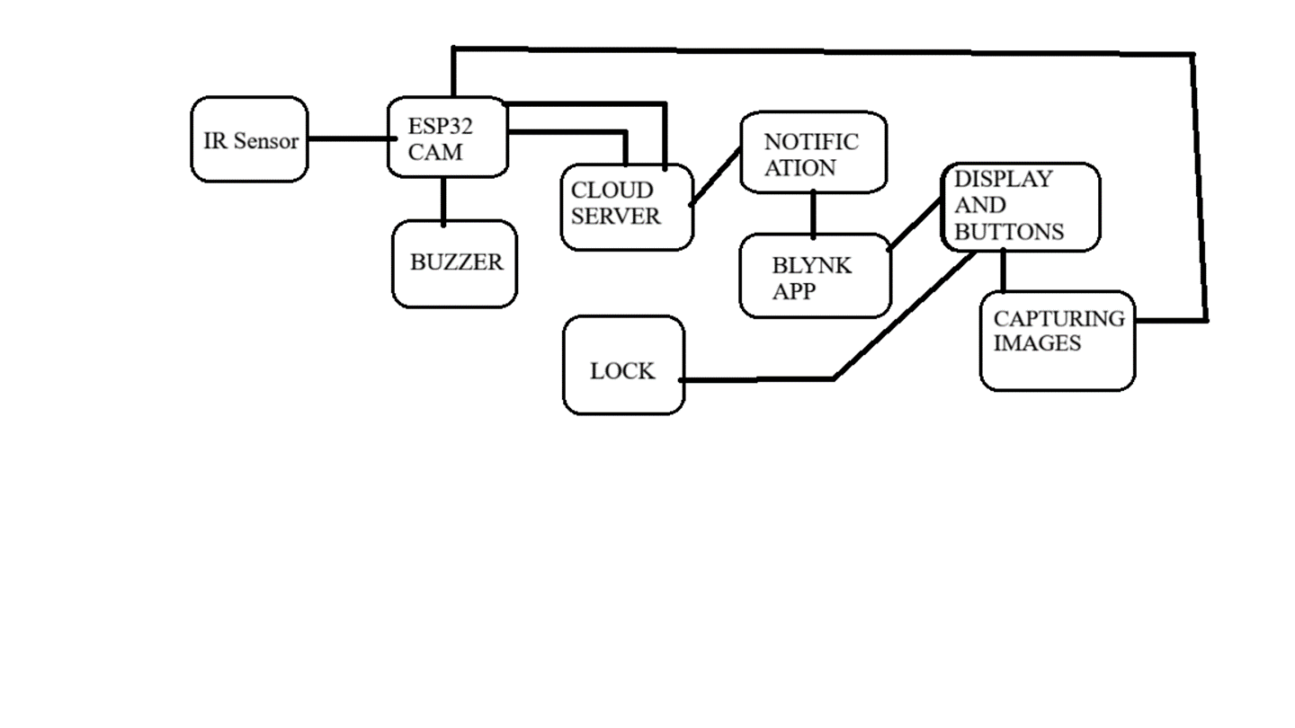
ARCHITECHTURE DIAGRAM

Slide 13
System Architecture:
Components and Interconnections:
1.Human Presence Detection Sensor:
2.Microcontroller:
3.Camera Module:
4.Local Cloud Server (Hosted on Windows Platform):
5.Smartphone App (iOS/Android):

Slide 14
Design Requirements:
Identification and explanation of the specific requirements for the IoT design project:
1.Accurate Human Presence Detection
2.Real-Time Alerts and Image Capture
3.Secure Data Transmission
4.User Authentication and Access Control
5.Intuitive User Interface
6.Compatibility and Interoperability
7.Local Cloud Server Setup
8.Energy Efficiency
9.Remote Door Unlock Functionality:
10.Responsive Real-Time Communication:
11.User Privacy:
12.Scalability and Performance:

Slide 15
Design Requirements:
Considerations for hardware, software, connectivity, security, and user experience:
1. Hardware:
Sensor Selection
Camera Quality
2. Software:
App Interface
Local Cloud Server Software
Compatibility
3. Connectivity:
Network Options
Stable Connection
4. Security:
Encryption
User Data Protection
5. User Experience:
Ease of Use
Speed and Responsiveness

Slide 16
Hardware Design :
1. LED and Resistor (1 ohm)
2. 12V Battery
3. Breadboard
4. Buzzer
5.Solenoid Lock
6.Push Button
7.Relay Module
8.UART TTL Module
9.7805 IC Voltage Regulator
10.25V 100uF Capacitor
11.IR Proximity Sensor
12.ESP32-CAM

Slide 17
Results and discussions
Results:
Hygiene and Safety Improvement
Enhanced Security
Convenience and Remote Access
Delivery Management
Visitor Records
Customization
Energy Efficiency and Environmental Impact
Discussions:
Privacy Concerns
Cost vs. Benefits
Accessibility
Integration with Smart Homes
Effectiveness in Pandemic Control
Technological Advancements

Slide 18
Conclusion:
Enhanced Security: By reducing physical contact with the doorbell button, the system minimizes the risk of transmitting germs or fingerprints, improving overall hygiene and security.
Remote Monitoring: Many contactless doorbell systems include cameras and smartphone apps, allowing homeowners to see and communicate with visitors even when they're not at home. This feature enhances security and convenience.
Customization: These systems often offer customizable settings, allowing homeowners to tailor their doorbell experience, such as setting different chimes or adjusting sensitivity to motion or touch.
Integration: Many contactless doorbell systems can integrate with other smart home devices, enhancing the overall home automation experience.

Slide 19
Future Work:
Improved Sensing Technologies: Future systems can benefit from more advanced and reliable sensors to detect touch or motion accurately, reducing false positives or negatives in detecting visitors.
Biometric Authentication: Integrating biometric authentication methods, such as facial recognition, could add an extra layer of security, allowing the system to recognize authorized individuals automatically.
Energy Efficiency: Developing more energy-efficient contactless doorbell systems with low-power components to reduce environmental impact and the need for frequent battery changes.
Integration with Smart Home Ecosystems: Seamless integration with other smart home devices, like smart locks and home security systems, can offer a more holistic approach to home security and automation.
Cybersecurity and Privacy: Addressing cybersecurity concerns to protect against potential hacking or data breaches and ensuring that the privacy of residents and visitors is maintained.
Cost Reduction: Working to reduce the cost of contactless doorbell systems to make them more affordable and accessible to a broader range of homeowners.

Slide 20
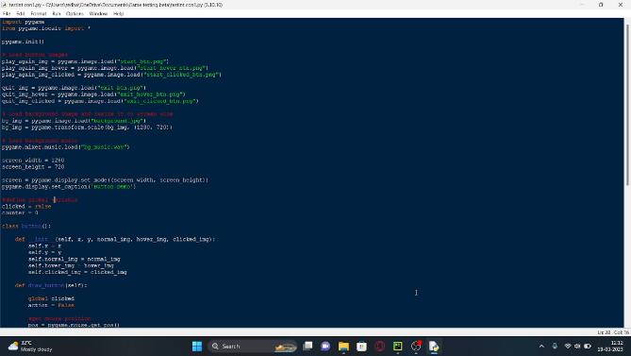
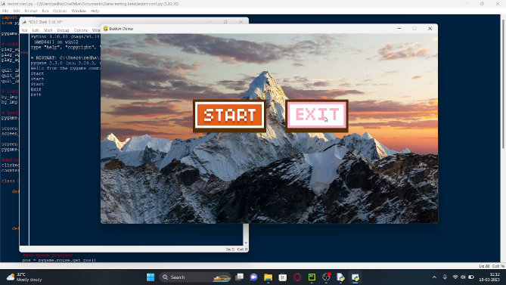
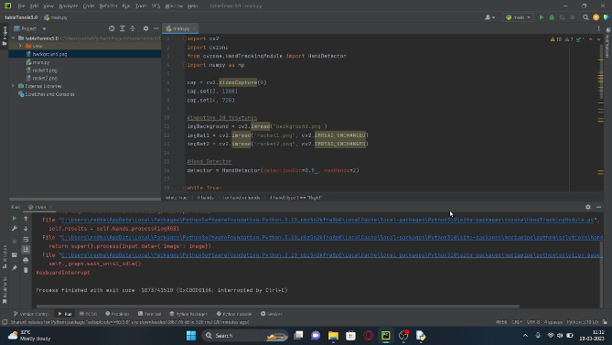
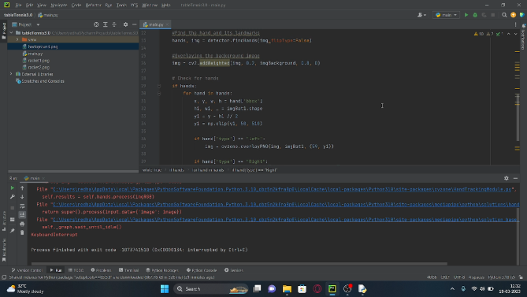
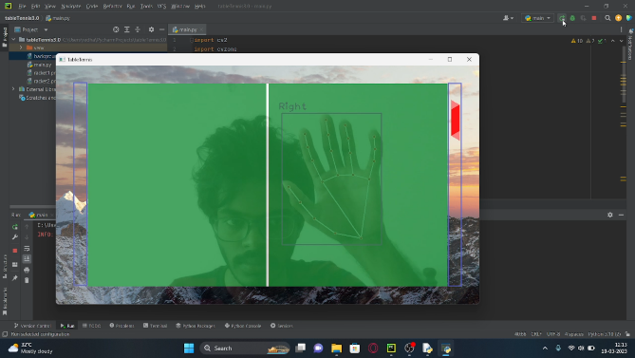
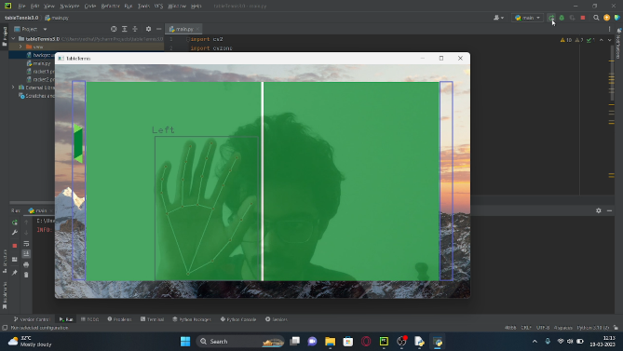
Screenshots

Slide 21
Contribution of Team members
Harish Jayaram S S (21113050)
Gathering Information such as Research paper, Images, Youtube videos for reference
Learning Python Opencv, pygame integration
Making ppt slide such as Intro, Objective, Architecture Diagram, System requirements, Future work and conclusion, Literature Survey such as Machine Vision Based Ping Pong, Machine Learning with Pong Game, conclusion and Future work
Making the pygame Interface and testing it
Accessing Camera module
Dharshan R E (21113049)
Gathering Information such as Research paper, Camera accessing, Youtube videos for reference
Learning Python Mediapipe, pygame button module integration with wav
Making ppt slide such as Abstract, Goals and Motivation, Module and Modular description, Problem definition, Literature Survey such as Pong game using Ai, VHDL, FGPA, Proposed System/Work, Result and discussion
Making The pygame button modules and testing it
Detecting the Hands and its landmarks
Abirajah (21113069)

Slide 22
References
Ben Thabet and N. Ben Amor, "Enhanced smart doorbell system based on face recognition", 2015 16th International Conference on Sciences andTechniques of Automatic Control and Computer Engineering (STA), pp. 373-377, 2015.
M. Khan, H. Anum, S. S. Batool and B. Bashir, "Smart Home with Wireless Smart Doorbell with Smart Response", 2021 International Conference on Electrical Computer Communications and Mechatronics Engineering (ICECCME), pp. 15, 2021.
A. Basit, K. Saxena and A. Rana, "A Wearable Device used for Smart Doorbell in Home Automation System", 2020 IEEE International Women in Engineering (WIE) Conference on Electrical and Computer Engineering (WIECON - ECE), pp. 90-93, 2020.
A. Ennis et al., "Doorstep: A doorbell security system for the prevention of doorstep crime", 201638th Annual International Conference of the IEEE Engineering in Medicine and Biology Society (EMBC), pp. 5360-5363, 2016.
W.-H. Park and Y.-G. Cheong, "IoT smart bell notification system: Design and implementation", 2017 19th International Conference on Advanced Communication Technology (ICACT), pp. 298-300, 2017.
Q. I. Sarhan, "Arduino Based Smart Home Warning System", 2020 IEEE 6th International Conference on Control Science and Systems Engineering (ICCSSE), pp. 201-206, 2020.
O. V. Biryukova and I. V. Koretskaya, "Selection of Ultrasonic Sensors for Distance Monitoring", 2020 Systems of Signal Synchronization Generating and Processing in Telecommunications (SYNCHROINFO), pp. 14, 2020

Slide 23
THANK YOU

